Slide 1


Raising the Bar
Creating & Sustaining a Culture
of Service Excellence

Slide 2
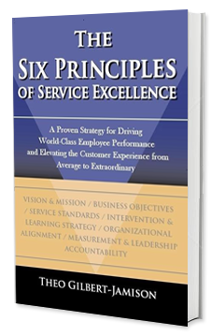
What We Will Cover
The Foundation for Driving Excellence
Defining Service Excellence (Service vs. Excellence) 
What an Exceptional Experience Looks, Sounds, and Feels like
Is There Purpose in Your Work (Function vs. Purpose) 
Service Excellence Gap Analysis
The Six Principles of Service Excellence
Service Excellence Gap Analysis 
The 3-Levels of Organizational Effectiveness
Raising the Bar – Elevating the Customer Experience
11 Simple Ways to Create Customer Loyalty & Delight 
The 4-Step Service Recovery Process (LEAP)
Responding with Empathy & Compassion (Heart-Head-Heart) 
Applying What You Have Learned
Identifying Barriers & Solutions 
Personal Commitment to Excellence 
Wrap-Up / Next Step 

Slide 3

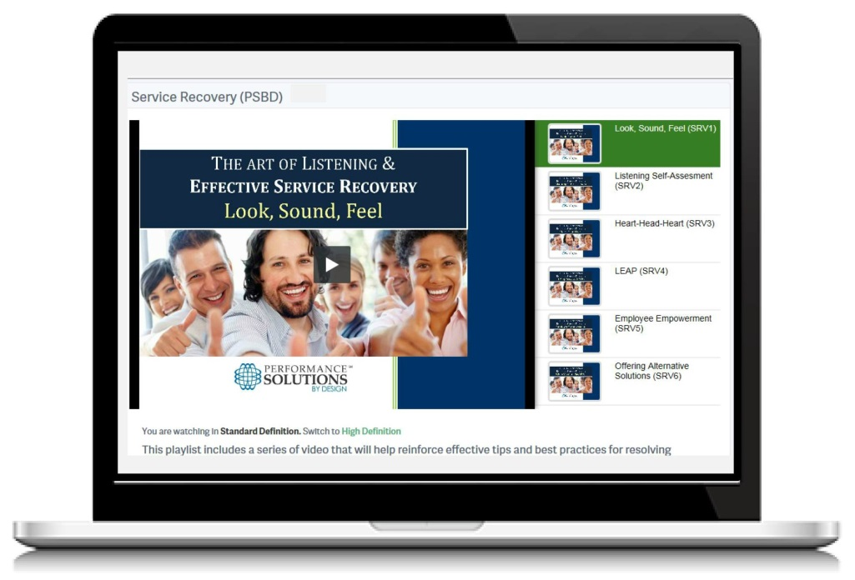
Facilitator Background
Company founded November 2003
17 Years with The Ritz-Carlton Hotel Company
Background in HR, Learning & Development, Lean/Six Sigma, and Process Improvement
9 Published Books on Service Excellence, Leadership Effectiveness, and Employee Accountability
4 Signature Workshops focusing on Service Excellence, Service Recovery, Accountability, and Leadership
Industries - Healthcare, Legal and Financial Services, Luxury Retail, Hospitality, Academic, and Private Clubs

Slide 4






















Some of our Clients

Slide 5
Personal Commitment to Excellence
START | STOP | CONTINUE
Focusing on my PURPOSE Anticipating customer needs before they have to ask Using LEAP (the 4-Step Service Recovery Process) when resolving problems, issues, or complaints Using Heart-Head-Heart when responding to complaints and problematic issues | Putting too much emphasis on FUNCTION Only focusing on my department, and not thinking about how my work and action might affects others Interrupting when others are speaking Taking rude comments from upset customers personally Multi-tasking while someone is speak, instead of giving them my full attention | Showing genuine concern for my internal and external customers Being more solution-focused, not problem-focused Proactively anticipating problematic issues before they occur or escalate Practicing the “Golden Rule”, treating others the way I expect to be treated

Slide 6
Opening Quote
The customer is the most important visitor on our premises.
He is not dependent on us. We are dependent on him.
He is not an interruption of our work. He is the purpose of it.
He is not an outsider of our business. He is part of it.
We are not doing him a favor by serving him.
He is doing us a favor by giving us the opportunity to do so.
--Mahatma Gandhi

Slide 7

Ground Rules
Be Open-Minded
Be Here (Stay Focused)
All Technology Off (this includes Cell Phones, Tablets, Laptops, etc.)
No Sidebar Conversations
Everyone Participates
Promptness
Its OK to Attack Issues, Not People
Parking Lot

Slide 8
Introductions
Challenges
Time Constraints
Misalignment/ Miscommunication
Lack of Teamwork
Lack of Accountability
Inconsistency in Service
Staffing Issues
Competing Priorities
Complacency/Inertia
Name / Position
How long have you been with the company?
What is a customer service challenge we are currently facing?
What would you like to gain during this session?

Slide 9
The 3-Levels of Employee Engagement
Non-
Believers
(Disengaged)
Change
Agents
(Fully Engaged)
Believers
(Engaged)

Slide 10
Interesting Facts…
Interesting data that validates why a focus on the total customer experience is crucial:
70% of buying experiences are based on how the customer feels they are being treated.
It is 6-7 times more costly to attract a new customer than it is to retain an existing customer.
Consumers are 2 times more likely to share a bad customer experience than they are to talk about positive experiences.
Consumers are 11 times more likely to share an exceptionally “memorable” experience, return to repurchase, and to pay more with your organization.
As little as a 10% increase in customer loyalty can result in a 30% increase in sales .
80% of companies believe that they offer a “great” customer experience; only 8% of customers concur.

Slide 11
Raising the Bar
The Three Dangers
that impede Service &
Profit Dominance
Compromise
Lack of
Accountability
Inconsistency

Slide 12
Defining Service Excellence
Service
Excellence
“Customer relations are an integral part of our job, not an extension of it.”

Slide 13
Defining Service Excellence
Service
Excellence
Knowledgeable
Timely
Accurate
Friendly
Courteous
Responsive
Respectful
Personalized
Anticipatory
Proactive
Genuine
Empowered
Passionate
CONSISTENT
“Customer relations are an integral part of our job, not an extension of it.”

Slide 14
What an Exceptional Experience should Look, Sound, and Feel Like from the customer’s perspective
Look | Sound | Feel
WORK ENVIRONMENT
Public Areas are clean and organized, no visible debris
Work Stations are neat and organized
EMPLOYEE DEMEANOR
Employee attire is professional, wearing proper name tag
Employee greets customer with a warm and friendly smile
Employee uses positive, direct eye contact when interacting with the customer
Employee displays a sincere desire to meet the customer requests
INITIAL GREETING
Customer receives friendly, enthusiastic greeting of “Welcome”; “Good morning/afternoon/evening”
Employee provides their name and offers assistance. “My name is ___, May I have your photo ID please? Are you a buyer or an exhibitor?”
If the customer has to wait, employee politely advises that they will be taken care of shortly
Employee’s speech is clear and professional, avoiding slang or industry jargon that may confuse the customer
CLOSING
Employee thanks the customer for their business “Mr. ___, have a great Market!”
VALUE/RESPECT
Employee is efficient, yet unhurried and sensitive to the customer’s needs
WELL SERVED
Employee provides prompt recognition, customer does not feel like an interruption to their work – they leave feeling well served
COMPETENT STAFF
Employee is knowledgeable and confident in their work; able to multi-task with ease
SENSE OF URGENCY
If a customer expresses a problem or concern, we LEARN (Listen, Empathize, Apologize, Resolve, and Notify) to quickly resolve it
TEAMWORK
Employees enjoy working together, and jump in to assist one another (especially during peak periods)

Slide 15
Is there Purpose in our work?
MY Function | MY Purpose
Create the training program
Create the participant handouts
Ensure room set-up is adequate
Make sure we have proper A/V equipment
Teach the class
Take attendance
Test for retention
Inspire and motivate positive change
Help participants link the learning to their job and the goals of the organization
Actively engage participants in the learning experience
Enhance the skill, knowledge, and talent of the participants
Reward and recognize superior performance
How does it feel when you work for a leader who is solely focused on function?
What percentage of your time do you spend focusing on purpose?
What happens when you spend too much time focusing on functional tasks?
What happens to your spirit when you spend to much time on the functional aspects of your job?

Slide 16
What We Will Cover
The Foundation for Driving Excellence
Defining Service Excellence (Service vs. Excellence) 
What an Exceptional Experience Looks, Sounds, and Feels like
Is There Purpose in Your Work (Function vs. Purpose) 
Service Excellence Gap Analysis
The Six Principles of Service Excellence
Service Excellence Gap Analysis 
The 3-Levels of Organizational Effectiveness
Raising the Bar – Elevating the Customer Experience
11 Simple Ways to Create Customer Loyalty & Delight 
The 4-Step Service Recovery Process (LEAP)
Responding with Empathy & Compassion (Heart-Head-Heart) 
Applying What You Have Learned
Identifying Barriers & Solutions 
Personal Commitment to Excellence 
Wrap-Up / Next Step 

Slide 17
The Six Principles of Service Excellence
is a comprehensive approach to effectively improving the work environment, employee performance and the service experience for your customers all in one initiative.
Senior Leadership
Alignment & Accountability
Principle 2
Business
Objectives
Principle 3
Service
Standards
Principle 4
Intervention
& Learning
Strategy
Principle 5
Organizational
Alignment
Principle 6
Measurement
& Leadership
Accountability
Principle 1
Vision and Mission Statement

Slide 18
The Six Principles Gap Analysis
Principle 1: Vision and Mission (Score ________)
We have a clearly defined vision and mission
The vision and mission of our company are clearly understood by all employees
The vision and mission of our company are acted on by our leaders
Our vision and mission clarify our commitment to delivering exceptional service
The vision and mission of our company are acted on by our employees
Principle 2: Business Objectives (Score ________)
I know the company goals and objectives
Our company goals are aligned with our vision and mission
Departmental goals are aligned with the company goals
Employees in my department strongly support the company and departmental goals
Principle 3: Service Standards (Score ________)
We have clearly defined Service Standards
Our Service Standards support the Vision, Mission and Values
Our leaders and employees know your Service Standards
Our Service Standards are acted on regularly by leadership and employees
We have sound processes in place to support the execution of our Service Standards
Everyone within the organization is held accountable for upholding the Service Standards
Principle 4: Intervention & Learning Strategy (Score ________)
We have an excellent process for identifying service gaps
We have an excellent process for solving or closing service gaps
Our service philosophy is integrated in all aspects of employee training and HR processes (for employees and leaders)
Our employees feel comfortable pointing out defects within the organization
Employees are encouraged to participate in the selection and implementation of process improvements
Principle 5: Organizational Alignment (Score ________)
We use all internal communication tools and resources (meetings, bulletin boards, newsletters, training, etc.) to energize our Service Philosophy
When making decisions our Service Philosophy is always taken into consideration
Our Service Philosophy is displayed throughout Departments
Our leaders use relevant stories, examples, and best practices to clarify and reinforce our Service Philosophy
Principle 6: Measurement/Leadership Accountability (Score ____)
We have an effective customer satisfaction survey process
We have an effective employee satisfaction survey process
We share and act on the results and feedback from the surveys
We have an effective process for tracking customer problems
We have an effective process for holding leaders accountable for service improvements
We have an effective process for holding employees accountable for delivering outstanding service
service

Slide 19
The 3-Levels of Organizational Effectiveness
Level I
CREATES THE BASIS FOR THE CULTURE
Level II
CREATES THE BASIS FOR SUSTAINABILITY
Level III
CREATES THE BASIS FOR CONSISTENCY
Principle 1: Vision/Mission
Principle 2: Business Goals
Principle 3: Service Standards
Principle 4: Intervention &
Learning Strategy
Principle 5: Organizational Alignment
Principle 6: Measurement &
Leadership Accountability

Slide 20
What We Will Cover
The Foundation for Driving Excellence
Defining Service Excellence (Service vs. Excellence) 
What an Exceptional Experience Looks, Sounds, and Feels like
Is There Purpose in Your Work (Function vs. Purpose) 
Service Excellence Gap Analysis
The Six Principles of Service Excellence
Service Excellence Gap Analysis 
The 3-Levels of Organizational Effectiveness
Raising the Bar – Elevating the Customer Experience
11 Simple Ways to Create Customer Loyalty & Delight 
The 4-Step Service Recovery Process (LEAP)
Responding with Empathy & Compassion (Heart-Head-Heart) 
Applying What You Have Learned
Identifying Barriers & Solutions 
Personal Commitment to Excellence 
Wrap-Up / Next Step 

Slide 21
11 Simple Ways to Create Loyalty & Delight
We greet everyone with a warm & friendly smile.
We anticipate and comply with customer needs.
We learn something unique about each customer to personalize the experience and to create loyalty and delight!
We use the customer’s name, if and when possible.
We use positive eye contact to indicate that we are interested and attentive.
We listen carefully and empathically with our ears, eyes and heart.
We are polite in our speech, using words like “Good morning/afternoon/ evening,” “I’ll be happy to,” “Please,” and “Thank You.”
We use proper telephone etiquette by answering with smile, thanking the caller, giving them our name, using hold carefully, and keeping them updated if they are on hold. 
If the customer has experienced a problem, we apologize and work to quickly resolve it. Then we follow-up to ensure satisfaction. LEAP! 
We maintain a professional appearance and a clean, organized work area.
We escort instead of pointing out directions when possible.

Slide 22

Team Huddles
What’s the Purpose?
We use Team Huddles as an opportunity to:
Discuss our Service Standards
Share Examples or Stories that Reinforce our Commitment to Excellence
Recognize Consistent Demonstration of Service Excellence
Review Complimentary Customer Letters and Survey Results
What is a Team Huddle?
What are the benefits?
How often will we conduct them?
Who should facilitate them?
What happens if we don’t have them?
How do we ensure consistency in the information relayed?

Slide 23
L | Listen to the customer to genuinely understand the problem from their perspective. Allow them to express or vent the issue. Don’t interrupt. Maintain eye contact. Say “I understand” occasionally and nod your head to show attentiveness.
E | Empathize with the customer, and apologize. Saying you’re “sorry” does not mean you are admitting wrongdoing. It is simply identifying that you are listening and understand what they are saying. This is known as empathy. Use “I” instead of “we” and “us.” If possible use their name, saying, “Please forgive me, Mr. Smith,” or “I apologize” to signify ownership.
A | Ask how we can resolve the problem. Always offer them reasonable alternatives. This may require you do some research or get someone else involved. Take notes, if needed, to get all of the details.
P | Produce a solution to solve or correct the problem right away, getting your manager or supervisor involved if necessary. If you can resolve the issue – then do it! If it is something that needs time, give the customer a time frame of when you will get back to them. Maintain a high level of energy and respond quickly to the customer’s needs. Follow-up to ensure the issue is resolved to the customer’s satisfaction.

Slide 24
Key Phrases
Diffusing Problematic Situations
Don’t Say
I can’t
I don’t know
That’s not my job
We’re short staffed
Calm down
That’s not my fault
Our policy doesn’t allow that
I’m new
Do Say
What I can do is
I’ll find out for you
I’ll get someone to help you
I understand your concern
Let’s see what I can do
I’ll be with you in just a moment
Here’s what I can do
Let me find someone to help you

Slide 25
Responding with Empathy…
Heart-Head-Heart (Key Words & Phrases)
Heart – use your heart for demonstrating empathy.
Head – use your head for providing information, solving problems, etc.
Heart – use your heart for reinforcing that you care.
Key Phrases
I apologize for the inconvenience
I’m sorry to hear that
Thank you for bringing that to my attention
Let me see what I can do
I appreciate your patience

Slide 26
Heart-Head-Heart (Practice Activity)
Courtesy / Respect - The customer feels that the employee serving them was rude and disrespectful when they asked for assistance. They are extremely upset.
Misinformation – The customer called to get hours of operation and was given incorrect information. Now they feel that everyone is incompetent.
Billing – The customer is complaining that they have been overcharged for a specific service and that their bill is incorrect. They are making a scene in the lobby area.
Wait Time – A customer complains that they have been waiting for an unreasonable amount of time to be served. They have observed other customers get served before them and they are very upset.

Slide 27
When You Can’t Say “Yes”
From time to time we will all be faced with having to say “no”. However, when it comes to saying no you should keep three things in mind.
Sometimes circumstances force you to say no
Saying yes does not guarantee a happy customer
Saying no does not mean that you have to end up with an unhappy customer
“I apologize; I can’t accommodate your request.
However, here are a few options that might work for you… Again, please accept my apology.”

Slide 28
What We Covered…
The Foundation for Driving Excellence
Defining Service Excellence (Service vs. Excellence) 
What an Exceptional Experience Looks, Sounds, and Feels like
Is There Purpose in Your Work (Function vs. Purpose) 
Service Excellence Gap Analysis
The Six Principles of Service Excellence
Service Excellence Gap Analysis 
The 3-Levels of Organizational Effectiveness
Raising the Bar – Elevating the Customer Experience
11 Simple Ways to Create Customer Loyalty & Delight 
The 4-Step Service Recovery Process (LEAP)
Responding with Empathy & Compassion (Heart-Head-Heart)
Applying What You Have Learned
Identifying Barriers & Solutions 
Personal Commitment to Excellence 
Wrap-Up / Next Step 

Slide 29
Identifying Barriers & Solutions
Service Excellence
Happy, Loyal customers
Fully Engaged Staff
Alignment with our Mission & Service Standards
Increased Customer Satisfaction
Increase Productivity & Profitability
Barriers
Time
Accountability
Negativity
Communication
Identify solutions you believe we can apply to overcome these
barriers and exceeding customer Expectations.

Slide 30
Identifying Barriers & Solutions
What Barriers might prevent your team from consistently providing exceptional service?
List Solutions you believe we can apply to overcome these barriers in Raising the Bar.
Our Barriers | Potential Solutions
Lack of Time
Lack of Accountability
Negativity
Lack of Communication
PRIORITIZE your time
ANTICIPATE issues, so you can be prepared
Consider what you can DELEGATE or ASK for help with
Enlist TEAMWORK to resolve the issue forever
Start with SELF-ACCOUNTABILITY
ADDRESS issues immediately
Provide training that will increase EMPOWERMENT
ACKNOWLEDGE and REWARD small steps
Try to find the ROOT CAUSE of the negativity
Don’t PERPETUATE or feed into negativity
Don’t take it PERSONALLY
Find out how you can HELP
PARTICIPATE in Team Huddles/Line-Ups
Use FOLLOW-UP to close the loop/inform staff
Provide FEEDBACK (in a compassionate manner)
BE OPEN to feedback from others
ASK for and offer help when needed

Slide 31
Applying What You Have Learned…
Personal Commitment to Excellence
START | STOP | CONTINUE
Focusing on my PURPOSE Anticipating customer needs before they have to ask Using LEAP (the 4-Step Service Recovery Process) when resolving problems, issues, or complaints Using Heart-Head-Heart when responding to complaints and problematic issues | Putting too much emphasis on FUNCTION Only focusing on my department, and not thinking about how my work and action might affects others Interrupting when others are speaking Taking rude comments from upset customers personally Multi-tasking while someone is speak, instead of giving them my full attention | Showing genuine concern for my internal and external customers Being more solution-focused, not problem-focused Proactively anticipating problematic issues before they occur or escalate Practicing the “Golden Rule”, treating others with the highest levels of DIGNITY & RESPECT

Slide 32
Next Steps
Assess your team
Determine your Gaps
Devise a plan for Improvement
Involve and Empower your employees
Be a Role Model for Excellence
Create a Work Environment that Makes Focusing on the “Customer Experience” Sustainable, not a program of the month
Do not Compromise – be Consistent
Remember…There is No Excuse for substandard service!

Slide 33
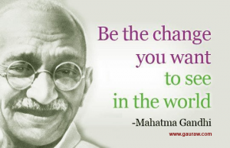
Workshop Evaluation

Slide 34


Contact Information
Email: tjamison@psbydesign.com
Website: www.psbydesign.com
Direct Telephone Line: (404) 630-2551

